Slide 1
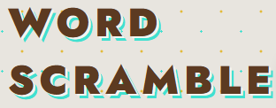
Word Scramble
Gamified Web3 Onboarding
Johnrick Rabara
July 2026
Notes:
Hi, I'm Johnrick Rabara. What if the very first blockchain transaction someone ever makes wasn't a scary DeFi swap — but solving a word puzzle? This is Word Scramble: a retro word game where every score you earn is a real transaction on the Stellar blockchain. It's live right now, anyone can play it in a browser, and today I'll show you how it turns casual gamers into on-chain users.

Slide 2
WORD SCRAMBLE
PROBLEM OVERVIEW
WEB3 ONBOARDING BARRIERS
Challenges in Web3 Onboarding
Getting a normal person onto a blockchain is hard — wallets, seed phrases, gas fees, test net faucets. Every one of those is a place people quit. And the way we usually teach Web3 is passive.
Meanwhile, casual word games — think Wordle — have proven that hundreds of millions of people will happily open a word puzzle every single day. Nobody has combined that habit with a real on-chain action. So onboarding funnels leak, and massive gaming audiences never even get exposed to blockchain.
Many potential users feel overwhelmed by wallets, seed phrases, and other unfamiliar terms . We hand people documentation and videos, but we never actually put a wallet in their hand and let them make a safe, low-stakes first transaction.
Existing education content lacks engagement, making it difficult for users to experience blockchain interactions and leading to high drop-off rates in onboarding funnels.
Non-technical users find onboarding intimidating and confusing due to complex processes.
Johnrick Rabara
Notes:
Here's the problem. Getting a normal person onto a blockchain is hard — wallets, seed phrases, gas fees, testnet faucets. Every one of those is a place people quit. And the way we usually teach Web3 is passive: we hand people docs and videos, but never put a wallet in their hand for a safe, low-stakes first transaction. Meanwhile casual word games like Wordle prove hundreds of millions will open a puzzle every day. Nobody has combined that habit with a real on-chain action — so onboarding funnels leak and huge gaming audiences never try blockchain.

Slide 3
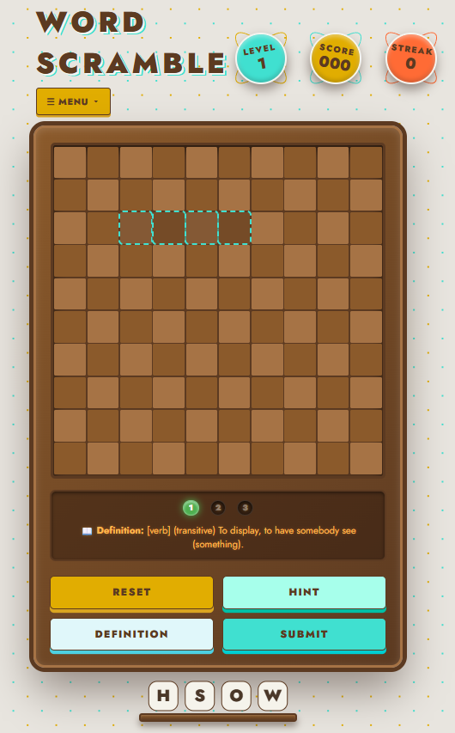
WORD SCRAMBLE ONBOARDING
SOLUTION OVERVIEW
Word Scramble
Drag-and-drop puzzle
The Word Scramble game features Soroban contracts that facilitate real on-chain transactions. With multi-wallet support and a guided walkthrough, users can easily connect and play. A live event stream enhances engagement by showcasing real-time player activity, making the onboarding experience interactive and fun.
Johnrick Rabara
Notes:
Our solution: make the blockchain invisible until the moment it delights you. You drag tiles, solve a word, and hit submit — and that submit is a real smart-contract call on Stellar, verifiable on Stellar Expert. Under the hood two contracts talk to each other: the leaderboard contract auto-calls a reward contract that mints a badge — Bronze, Silver, Gold, or Legend — in one transaction. Four wallets are supported, new accounts auto-fund via Friendbot, first-timers get a guided walkthrough, and a live event stream lights up whenever anyone submits a score.

Slide 4
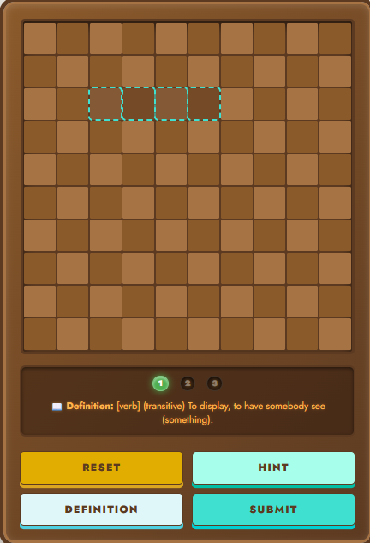
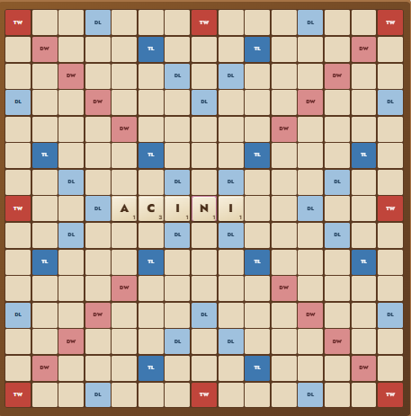
WORD SCRAMBLE — GAMIFIED
MARKET OPPORTUNITY
INTERSECTION OF GAMERS AND WEB3
The intersection of casual gamers and Web3 newcomers presents a unique opportunity for mass adoption and engagement.
Johnrick Rabara
Casual Market
Financial Inclusion
Casual game markets are massive, driving daily engagement and attracting a broad user base across demographics.
Proven success of games like Wordle highlights opportunities for real on-chain interactions to enhance user experience.
Stellar focuses on financial inclusion, lowering barriers for non-technical users to engage in the blockchain space.
Notes:
Why now, and why this? Casual word games are one of the most durable categories in gaming — Wordle turned a single mechanic into a daily habit for millions. At the same time, Stellar's mission is consumer financial inclusion — lowering the barrier for non-technical people. Word Scramble sits exactly at that intersection: it takes an audience that already loves word games and gives them a safe on-ramp to Web3. And because our expansion modes copy mechanics that already work, our growth path is de-risked.

Slide 5
WORD SCRAMBLE ONBOARDING
ARCHITECTURE OVERVIEW
TECHNICAL FLOW
Fully Client-Side Application
Overview
Technical Details
This application is designed to be fully client-side, using vanilla HTML, CSS, and JavaScript, ensuring seamless user experiences without backend dependencies.
The architecture leverages stellar.js to connect the UI with Soroban contracts, while event polling facilitates real-time updates. Continuous integration and analytics enhance performance tracking without user disruption.
Stellar
Stellar.js
Soroban
Johnrick Rabara
Notes:
Architecturally this is deliberately lean. The whole front end is vanilla HTML, CSS, and JavaScript — no backend, no build step — served as a static site. One file, stellar.js, bridges the game to two Soroban contracts via the Stellar SDK and Stellar Wallets Kit. On submit, the contract writes to a top-ten leaderboard only if you beat your best, then mints your badge in the same flow. The front end polls every five seconds so every tab sees new scores live. CI runs on GitHub Actions on every push, and privacy-friendly analytics track real usage.

Slide 6
User Acquisition and Retention Strategies
Recruitment Loop
Built-in Feedback
A proven loop from wallet connect to on-chain submit — scaled 10 → 51 verified users, 182 on-chain transactions, 100% independently verified.
Continuous improvement encouraged through auto-prompts and persistent feedback options after user interactions.
Retention Mechanics
Long-Horizon Growth
Speedrun and Weekly Arena modes cater to diverse player interests, driving repeat engagement and competition.
On-chain badges as verified skill proof open avenues for school tournaments and community engagement initiatives.
Notes:
Growth runs as a repeatable loop: recruit a player, they connect a wallet, submit a score on-chain, and we independently verify that transaction against Stellar's ledger — so our numbers aren't self-reported, they're cryptographically backed. We scaled from ten verified users to fifty-one, with a hundred and eighty-two real transactions and a hundred percent verification rate. Retention is built in — the game invites feedback right after your first score, and that loop has already shipped real fixes. Our next modes reuse systems we've already built.

Slide 7
Just shipped
- Scramble Board v2.0.0
- Feedback-driven UX fixes
Long-term
- On-chain vocabulary credentials
Near-term
- Real multiplayer
- Speedrun mode
- Difficulty Scaling
Mid-term
- Weekly Arena
- Category Rush
- Streak Freeze
FEEDBACK → ROADMAP
Feedback Future Roadmap
Shipped straight from player feedback: a clearer Definition button, plus Scramble Board v2.0.0 — the 2–4 player 15×15 board users asked for. Next on the roadmap: an on-chain daily leaderboard with streaks and commit-reveal fairness, seasons and player profiles, a timed Speedrun mode, and long-term, verifiable on-chain vocabulary credentials for schools.
Notes:
This is my favorite slide, because it proves the loop closes. Testers said the hint button was confusing — we renamed it to a clear Definition button. Several asked for a bigger, persistent, Scrabble-style board — so we built Scramble Board, a two-to-four-player fifteen-by-fifteen tile game, shipped as version two-point-oh. Ahead: moving the daily leaderboard fully on-chain with streaks and fair commit-reveal, adding seasons and profiles, a timed Speedrun mode, and long-term, evolving these badges into verifiable vocabulary credentials schools could recognize.

Slide 8
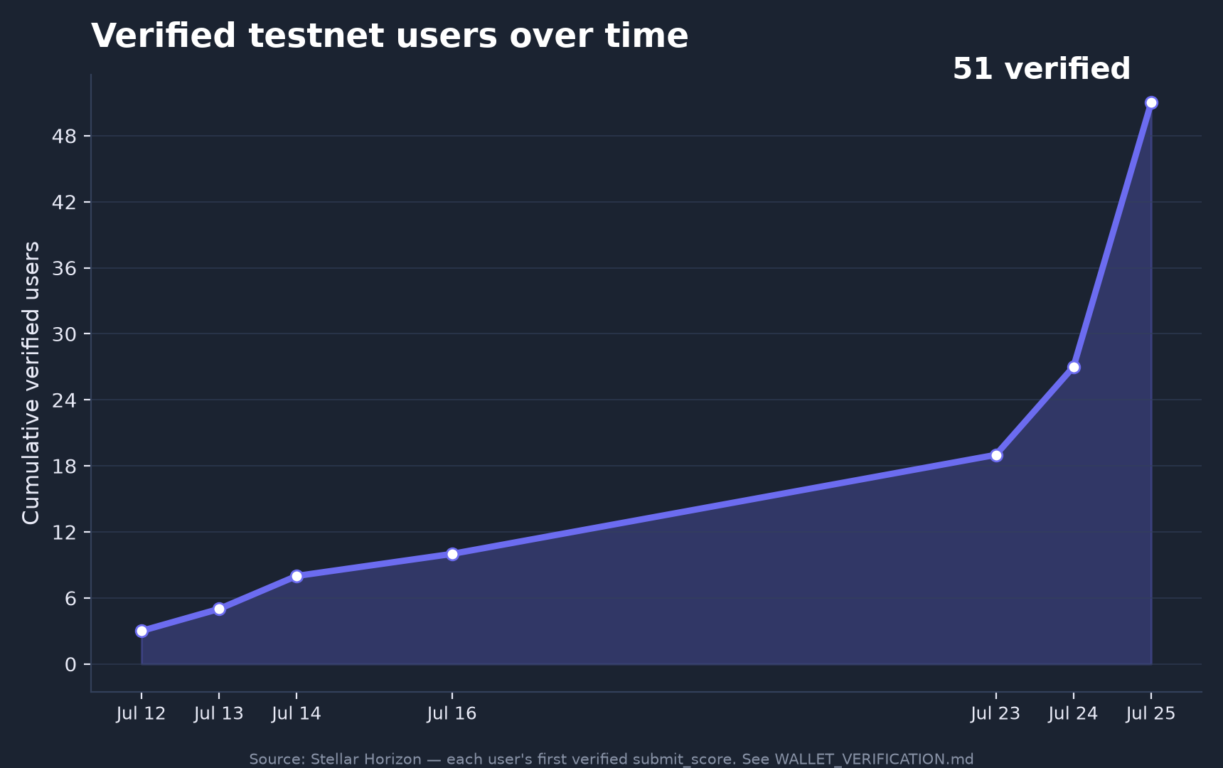
User Engagement Metrics
51 verified users · 182 on-chain txns
4.8/5
Average player rating (52 responses)
Notes:
To the numbers — this is live, and the traction is real and verified: fifty-one distinct users, every wallet independently cross-checked on Stellar Horizon for a genuine submit_score, a hundred percent verification rate across a hundred and eighty-two transactions. Players rate it four-point-eight out of five, and fifty-one of fifty-two say they'd play again. It's all open source with a passing CI pipeline, plus a full walkthrough video of the entire flow.

Slide 9
Thank you!
word-scramble-v1.surge.sh · github.com/Jrabara101/Stellar-Paradigm
Notes:
So my ask is simple: go to word-scramble-v1.surge.sh, solve one word, and you'll have made your first blockchain transaction without even realizing it. That's how we onboard the next million users to Stellar. Thank you.

